Slide 1

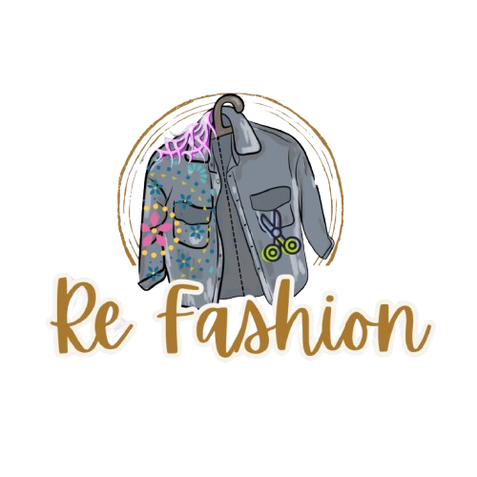


Marketing Plan Presentation
Refashion - The Future of Sustainable Fashion
1

Slide 2
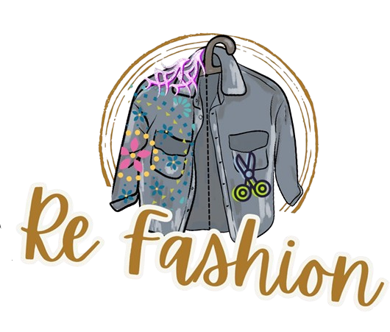

Content
1. Project planning & Mangement
3 . Requirements gathering
OBJECTIVE
Defining the project idea
THE 5 S SMART GOELS
Objectives
STRATEGY
Gnatt chart
STP
Survey
TARGET PERSONA
USP
Platforms & Tools
Roles and Responsibilities of the Team
2. BCM Review
4 . System Analysis & Design
Business Model Canvas
TACTICS
SITUATION ANALYSIS
THE 7 PS
CHANNELS
POSTING FRECUANCY
CONTENT TYPE
TONE OF VOICE
CONTENT CALENDER
INTERNAL ANALYSIS
CUSTOMER ANALYSIS
COMPETITORS ANALYSIS
SWOT ANALYSIS
Digital marketing strategies
Digital market trends ( Digital Egypt -2024 )
KPIs and Mockups
2

Slide 3

BRIEF: RE-Fashion
Project Overview
Refashion is a platform that combines selling clothing and offering repair and customization services, making it both a product and a service, marketed as a brand that promotes sustainable fashion through an interactive digital platform.
Encouraging users to repurpose clothes instead of discarding them.
Vision
To revolutionize the fashion industry by making sustainability the standard, not the exception.
Objective
Provide users with an eco-friendly, cost-effective, and creative way to extend the life of their clothes.
3

Slide 4

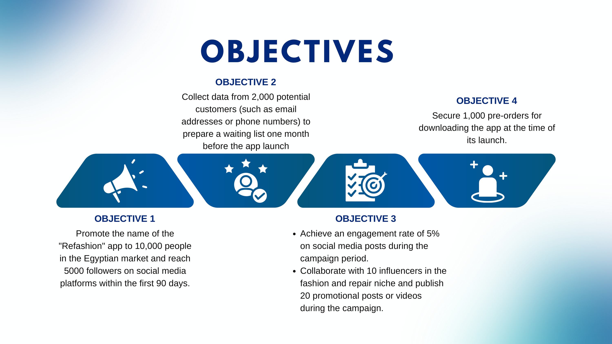
4

Slide 5
Project Timeline (Gantt chart):
December
January
February
Task
Ideation
12-16
Bayer persona
16-23
Internal Analysis
23-27
External Analysis
27-5
PEST Analysis
5-8
SWOT Analysis
8-11
Objective
11-15
7Cs
15-25
Content calendar
25-8
5

Slide 6

Platforms
Tools
Facebook
Instagram
Tik-Tok
LinkedIn
Pinterest
YouTube
X
SWOT analysis model
SOSTAC model
Google meet
WhatsApp community
Google drive
PEST analysis model
CapCut
Chat GPT
Deep seek
Meta ads
Fawry
Chatbots
AI
Canva
Power point
Word
Excel
Buyer persona
Google sheets
Recommended to use
Roles and Responsibilities of the Team
The team has collaborated on all responsibilities to
learn all aspects of the work.
6

Slide 7
Business Model Canvas
3
KEY PARTNERS
KEY ACTIVITIES
VALUE PROPOSITIONS
CUSTOMER RELATIONSHIPS
Clothing redesign: By local designers and specialized artisans.
Displaying and selling modified clothing on the app’s store.
Developing the Refashion app: Facilitating communication between customers and designers.
Environmental awareness campaigns: Promoting the concept and importance of clothing redesign.
Marketing and promotion: Expanding app usage and increasing brand awareness.
CUSTOMER SEGMENTS
Ministry of Trade and Industry.
Egyptian Clothing Bank: Contributing to the collection and sorting of donated clothes.
Local designers: Providing clothing redesign services.
Environmental organizations: Collaborating on environmental awareness campaigns.
Universities and educational institutions: Offering workshops and awareness lectures.
Environmental sustainability: Providing a sustainable solution for turning old clothes into trendy pieces.
Financial savings: Offering new clothes at a lower cost or for free.
Creativity and uniqueness: Designing unique outfits that reflect the customer's personality.
Supporting Egyptian designers: Empowering young designers and creating job opportunities.
Community awareness: Promoting sustainability to reduce natural resource consumption through clothing recycling.
Customer support: Providing excellent customer service through the app for inquiries and assistance.
Personalized communication: Direct interaction between customers and designers to discuss design details.
Building strong relationships with customers through tailored experiences and custom designs.
Enhancing social responsibility by offering workshops and training courses on clothing redesign.
Individuals who want to redesign their clothes: Seeking new and innovative designs.
Designers and artisans: Looking for new job opportunities and expanding their customer base.
Environmentally conscious individuals: Wanting to contribute to waste reduction and environmental protection.
Cost-conscious customers: Interested in reusing and revamping their clothes to look trendy at a lower cost than buying new ones.
CHANNELS
KEY RESOURCES
Mobile application: A platform for communication between customers and designers.
Social media: Sharing promotional and educational content.
Exhibitions and events: Promoting the app and attracting customers.
Website: Providing information about the campaign and how to use the app.
Technology and app development.
Database of designers and partners.
Order and design management system.
Human resources (designers, technical support team).
App development and maintenance costs.
Marketing and awareness campaign costs.
Operational and human resource costs.
Workshop and event organization costs.
Commissions from redesign transactions made through the app.
Subscription fees from designers and artisans for showcasing their designs on the app’s store.
Revenue from selling modified clothing through the app or at exhibitions.
Partnerships and sponsorships from sustainability-supporting institutions.
COST STRUCTURE
REVENUE STREAMS
7

Slide 8
Situation Analysis
8

Slide 9
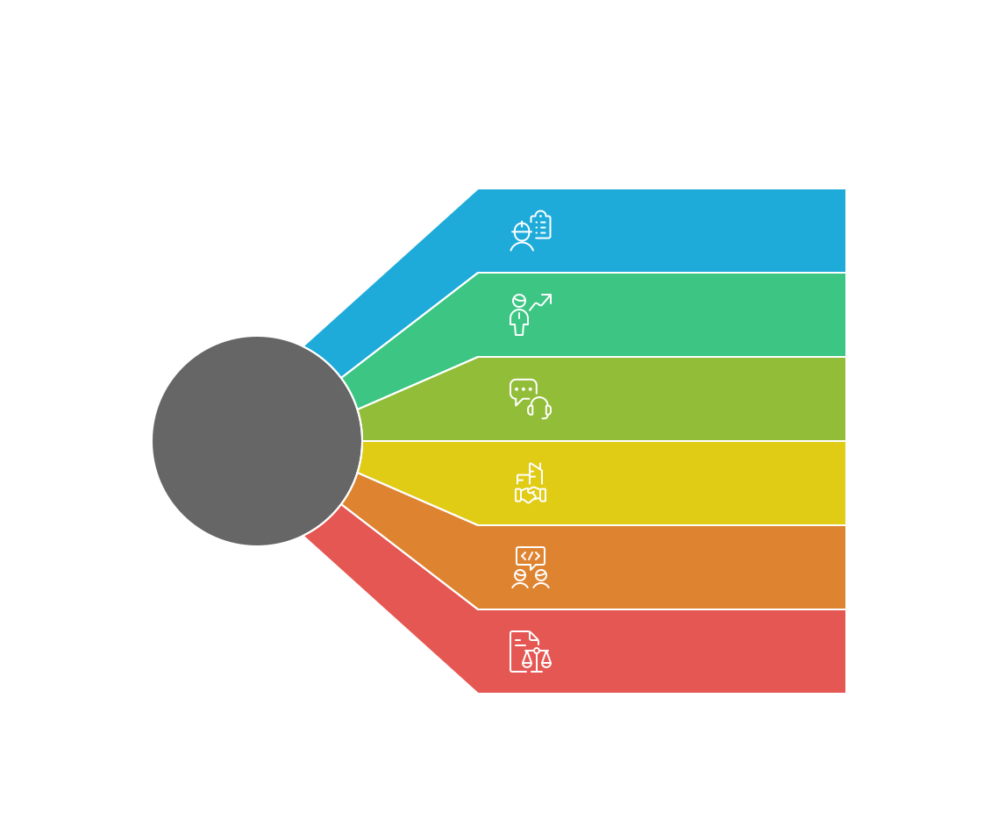
Need expertise in fashion design, recycling techniques, and customer service.
Employees require additional training in technology & customer handling.
Current gap: No dedicated team for order & customer management.
Employees & Skills
Senior Management Goals
Improve operational efficiency & customer satisfaction.
Offer financial incentives to employees.
Customer Service
Support team is available but needs more structured complaint handling.
Internal Analysis
Requires staff to manage supplier relationships.
Suppliers & Partners
Developers & Designers
Have a strong technical team but need better inter-department collaboration.
Legal & Compliance
Must ensure full compliance with business regulations.
9

Slide 10
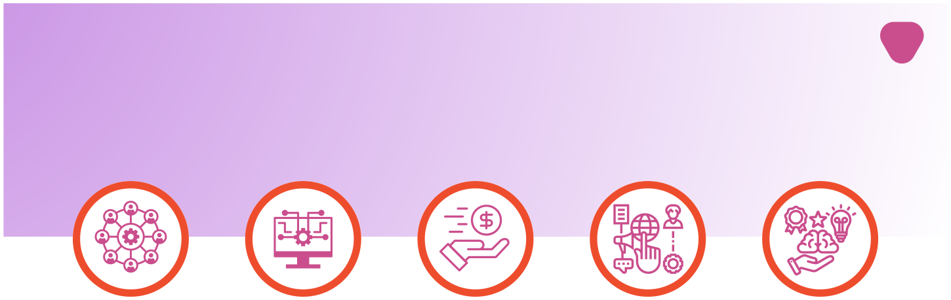
Internal Analysis: Resources
Human Resources
Technological Resources
Financial Resources
Marketing Resources
Conclusion
✅ Fashion Designers & Tailors:
Provide upcycling, customization, and repair services.
✅ App Developers & IT Team:
Maintain and update the platform to ensure smooth operation.
✅ Marketing & Social Media Team:
Handles brand awareness, advertising, and customer engagement.
✅ Customer Support Team:
Assists users with inquiries, orders, and designer coordination.
✅ Sustainability & Fashion Consultants:
Experts who guide Refashion in adopting sustainable fashion practices.
✅ Business Development & Partnership Managers:
Build relationships with designers, brands, and eco-conscious organizations.
✅ Refashion App & Website:
The main platform connecting customers with designers.
Supports order tracking, custom requests, and virtual consultations.
✅ Order Management System:
Tracks orders, service requests, and customer interactions.
✅ Database of Designers & Tailors:
Stores designer profiles, ratings, and completed projects.
✅ Payment System:
Secure payment gateway for transactions between users and designers.
✅ Social Media & Content Management System:
Tools for scheduling content, engaging audiences, and tracking performance.
✅ Initial Investment & Funding:
Includes budget for app development, marketing, and operations.
✅ Revenue Streams:
Service Fees: Commission on transactions between customers and designers.
Subscription Plans: Premium services for designers & customers.
Partnerships & Sponsorships: Collaborations with eco-friendly brands.
Workshop & Event Revenue: Paid training for sustainable fashion.
✅ Cost Structure:
App Maintenance & Updates
Marketing & Advertising
Salaries for Internal Teams
Customer Service & Order Management
✅ Social Media Channels:
Instagram, TikTok, Facebook, Pinterest, LinkedIn.
✅ Content Strategy:
Educational fashion tips, upcycling transformations, influencer collaborations.
✅ Workshops & Community Engagement:
Partnering with universities, NGOs, and sustainability advocates to educate users.
✅ Influencer Partnerships & Brand Collaborations:
Working with fashion bloggers and eco-friendly brands to expand reach.
Refashion’s resources are a mix of technology, people, funding, and marketing tools, all aligned to support its mission of sustainable fashion. These resources enable smooth operations, customer engagement, and business growth. 🚀♻️
10

Slide 11
Customer analytics
11

Slide 12
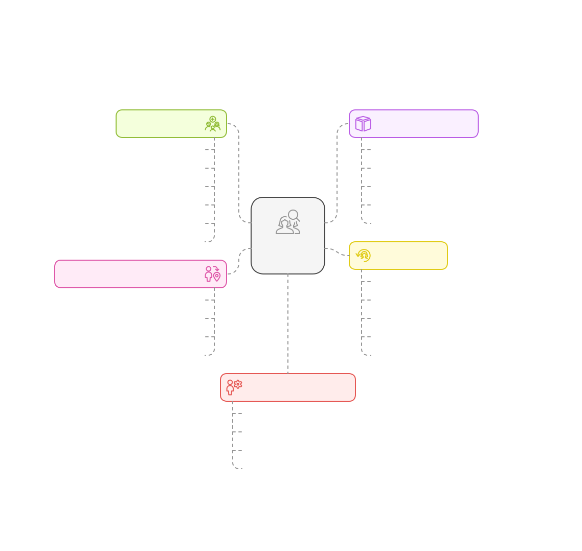





Customer Analysis for Refashion Services
Target Audience
Services & Offerings
Fashion-conscious Individuals
Upcycling & Customization
Eco-conscious Consumers
Alterations & Repairs
Budget-conscious Shoppers
Sustainable Fashion Marketplace
Parents & Families
Fashion Consultation
Social Media Influencers
Educational Workshops
Designers & Tailors
Customer
Analysis
Key Moments
Geographic & Digital Presence
Clothes Become Outdated
Urban Areas
Before Special Events
Online Platforms
Seasonal Wardrobe Changes
Social Media
Increased Eco-consciousness
Workshops & Events
Budget Constraints
Customer Motivations
Sustainability
Affordability
Uniqueness
Sentimental Value
12

Slide 13
competitors analytics
13

Slide 14
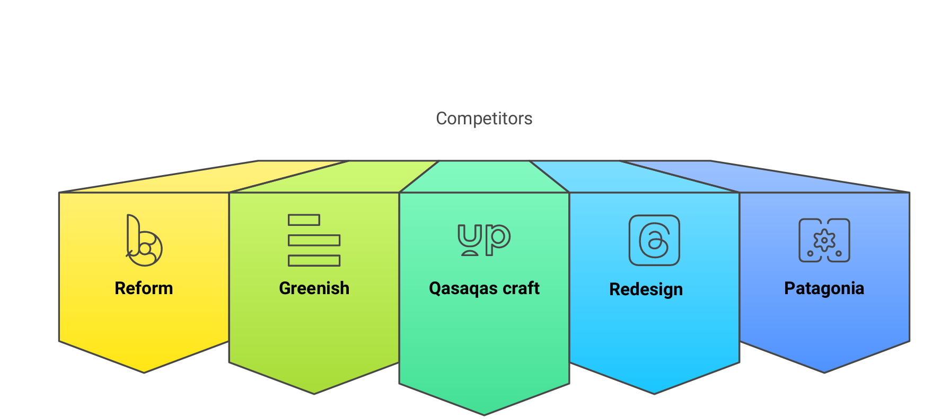
14

Slide 15
Competitor Analysis
1.Reform studio
Strengths
Weaknesses
Opportunities
Threats
Likely higher-end pricing due to innovation and design quality. May not cater to budget-conscious customers.
A well-established leader in Egypt’s upcycling industry, recognized with international and local awards. Strong brand image and credibility.
Expanding their market reach through collaborations or affordable product lines.
New entrants like Refashion might offer more affordable alternatives with modern approaches.
15

Slide 16
Competitor Analysis
2. Greenish
Strengths
Weaknesses
Opportunities
Threats
Focuses on raising awareness about sustainability, affordable pricing, and solving textile waste issues
May lack strong branding or premium appeal. Likely operates on lower profit margins
Could collaborate with NGOs or government initiatives to expand reach
Competitors with stronger branding could overshadow its impact
16

Slide 17
Competitor Analysis
3. قصاقيص كرافت (Qasaqas Craft)
Strengths
Weaknesses
Opportunities
Threats
Bigger competitors might capture more market share with better infrastructure
Specialized in fabric recycling, offers training programs, and has a social impact focus
Expanding training programs or integrating with fashion brands for larger impact
Limited scalability as it relies on small-scale workshops and training
17

Slide 18
Competitor Analysis
4. Re Design
Strengths
Weaknesses
Opportunities
Threats
A well-known brand in Egypt, established in 2013, focusing on upcycling and reselling clothes
May have limited differentiation if competitors offer unique product designs
Could expand into new digital platforms or international markets
New competitors with better technology-driven approaches
18

Slide 19
Competitor Analysis
5. Patagonia (International competitor)
Strengths
Weaknesses
Opportunities
Threats
Global reputation, sustainability leader, strong brand loyalty, and innovative eco-friendly designs
Expansion in Middle Eastern markets or partnerships with local brands
Local competitors providing more affordable sustainable fashion solutions
Expensive products, limited accessibility in Egypt
19

Slide 20


SWOT ANALYSIS
S
W
O
T
STRENGTHS
WEAKNESSES
OPPORTUNITIES
THREATS
✅ Strong Unique Selling Proposition (USP): Customization + Sustainability.
✅ Growing Demand for Sustainable Fashion.
✅ An innovative team from Generation Y and Generation Z.
✅ Affordable Pricing Model.
⚠ Fast Fashion Giants: Big brands might enter the sustainable space and increasing competition in the sustainable fashion industry .
⚠ Rapid changes in fashion trends
⚠Customer concerns about the possibility of errors in redesign
❌ Limited Brand Awareness: Still new in the market.
❌ No Dedicated Order Management Team.
💡 Rising Eco-Conscious Consumer Trends.
💡 Partnerships with Sustainable Brands.
💡 Expanding into International Markets.
20

Slide 21






OBJECTIVES
SELL
Serve
SPEAK
Save
SIZZLE
Increase sales by offering sustainable fashion alternatives through upcycling, repairs, and customization services.
Reduce costs through automation, minimizing returns, and using efficient marketing strategies.
Establish Refashion as a leading platform for sustainable fashion, creating a loyal community passionate about ethical and eco-friendly fashion.
Offer fast support, personalized recommendations, and styling tips to enhance customer satisfaction.
Engage with the audience through compelling content, success stories, and influencer collaborations.
21

Slide 22
SMART Goals
SMART Criteria | Refashion Goal
Specific (S) | Increase customer engagement and adoption of sustainable fashion through upcycling services.
Measurable (M) | Reach 5000 app downloads and achieve a 20% increase in monthly active users within the next 6 months.
Achievable (A) | Partner with at least 100 designers and tailors and complete 10,000 upcycling requests within the first year.
Relevant (R) | Align with global sustainability goals by reducing fashion waste by 30% among active users.
Time-bound (T) | Launch full platform features, including AI-powered recommendations and virtual styling, within the next 12 months.
22

Slide 23

Exploring the Best Digital Marketing Strategies for Our Project
Based on the Study of the Latest Digital Marketing Strategies, We Identified the Most Suitable ones for our Project:
We used Buyer Persona instead of Target Segment because it is more accurate in defining the target audience and better clarifies the project's characteristics.
We also used Organic Media instead of Paid Media to focus on authentic engagement and sustainable growth.
We adopted the Hub and Spokes model to centralize content creation and distribute it across multiple channels for wider reach.
We leverage User-Generated Content (UGC) to build trust and engage our community by showcasing authentic experiences.
23

Slide 24
Analyzing Digital Market Trends and Their Impact on Marketing Strategies
The "Digital 2024: Egypt" report provides comprehensive insights into Egypt's digital landscape as of early 2024. Key findings include:
Internet Usage: Approximately 82.01 million Egyptians were internet users, representing 72.2% of the population. This marks a 1.6% increase from the previous year.
Social Media Engagement: The country had 45.40 million social media users, accounting for 40% of the population.
Mobile Connectivity: There were 110.5 million active cellular mobile connections, equating to 97.3% of the population.
These statistics highlight the significant digital engagement in Egypt, with a high penetration of internet and mobile services. The substantial number of social media users underscores the importance of digital platforms in daily life. The near-total mobile connectivity suggests a robust infrastructure supporting widespread mobile communication.
24

Slide 25
Platform | Users (Approx.) | Primary Uses | Viewers' Activities
Facebook | 42 million | - News consumption - Business promotions & ads - Social networking & community building - Customer service interactions | - Scrolling through the feed - Watching short & long videos - Engaging with posts (likes, comments, shares) - Following pages & groups
YouTube | 41 million | - Entertainment (music, movies, shows) - Educational content & tutorials - Product reviews & influencer marketing - News updates | - Watching videos (on-demand & live) - Engaging via likes, comments, and shares - Subscribing to channels - Exploring trending content
Instagram | 17 million | - Visual content sharing (photos/videos) - Fashion, beauty & lifestyle trends - Business branding & influencer marketing - Engagement with younger audiences | - Watching Stories & Reels - Scrolling through feed images/videos - Engaging with influencer content - Saving and sharing posts
TikTok | 26 million | - Short-form entertainment videos - Viral trends & challenges - Influencer marketing & brand promotions - Community engagement through interactive content | - Watching short videos continuously (For You Page) - Engaging via likes, comments, and shares - Participating in challenges - Following creators
LinkedIn | 5 million | - Professional networking - Job searching & recruitment - Industry insights & business news - Corporate branding & B2B marketing | - Reading professional posts - Watching business-related videos - Engaging in discussions - Networking with professionals
X (Twitter) | 3 million | - Real-time news & updates - Political & social discussions - Customer service for brands - Sports & entertainment conversations | - Scrolling through tweets - Watching short videos & GIFs - Engaging via retweets, replies, and likes - Following trending topics
25

Slide 26


Based on the study of this report, we developed our plan to focus on creating Reels, short, engaging, and emotional content.
Data resources are from
Digital 2024: Egypt Report
26

Slide 27
STRATEGY
27

Slide 28
SEGMENTATIONS
Segment | Who They Are? | Needs & Interests
Fashion-Conscious Individuals 👗 | Trendy shoppers (18-35) | Unique & stylish clothing without buying new.
Eco-Conscious Consumers 🌱 | Sustainability-driven shoppers (25-45) | Ethical fashion & reducing waste.
Budget-Conscious Shoppers 💰 | Cost-conscious individuals (20-40) | Affordable alternatives to fast fashion.
Parents & Families 👨‍👩‍👧 | Parents (30-50) | Repurposing kids' clothing & cost savings.
Social Media Influencers 📸 | Content creators (18-35) | Standout, personalized fashion for branding.
Designers & Tailors (B2B) ✂ | Freelance designers (22-45) | Client connections & income opportunities.
28

Slide 29

TARGETING
Refashion will focus on two primary target segments:
1️⃣ Eco-Conscious Consumers who prioritize sustainability and ethical fashion.
2️⃣ Budget-Conscious & Fashion Enthusiasts looking for affordable, customized, and unique clothing.
Additional Focus Areas:
Parents seeking cost-effective solutions for kids' clothes.
Social media influencers who need unique outfits.
Designers who want to expand their client base.
29

Slide 30

POSITIONING
📌 "Refashion: Sustainable, Affordable, and Personalized Fashion at Your Fingertips."
Sustainable Fashion for Everyone – A platform for fashion lovers who care about the planet.
Fashion Without Limits – Transform, upcycle, and redesign clothes effortlessly.
Affordable & Accessible – The perfect alternative to fast fashion.
Tagline: ♻ "Revamp, Redesign, Refashion!"
30

Slide 31
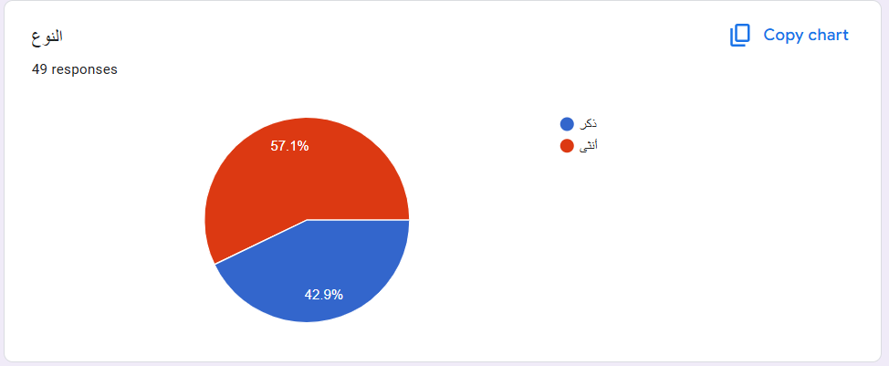
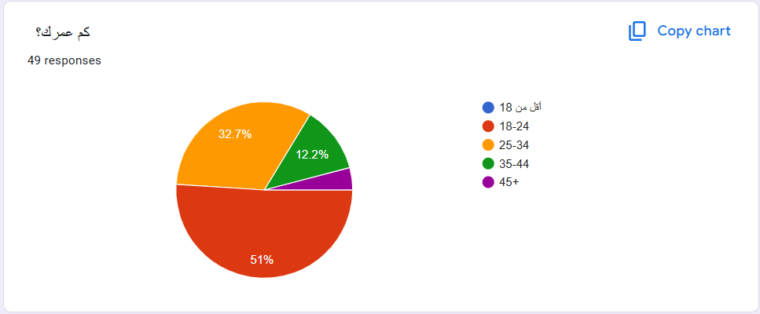
Survey
31

Slide 32
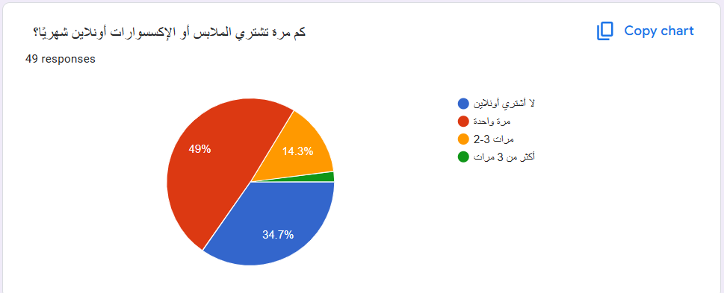
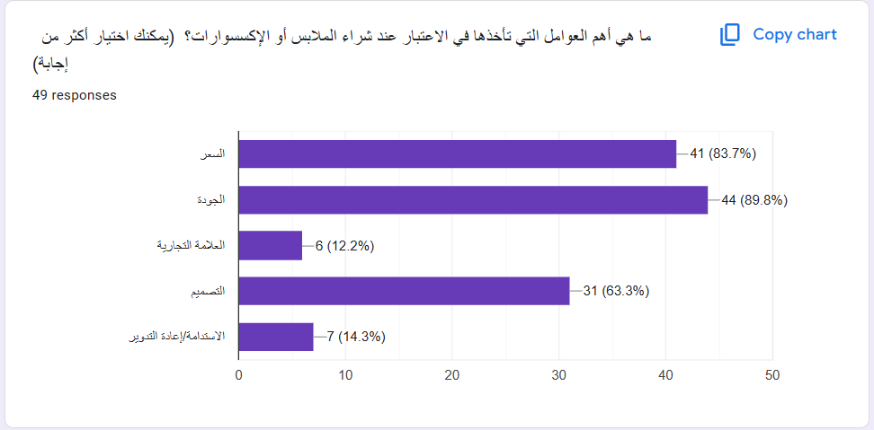
32

Slide 33
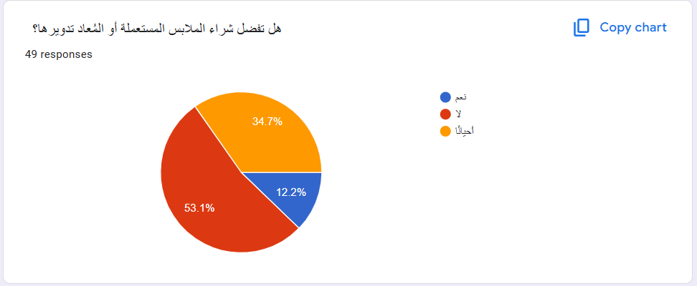
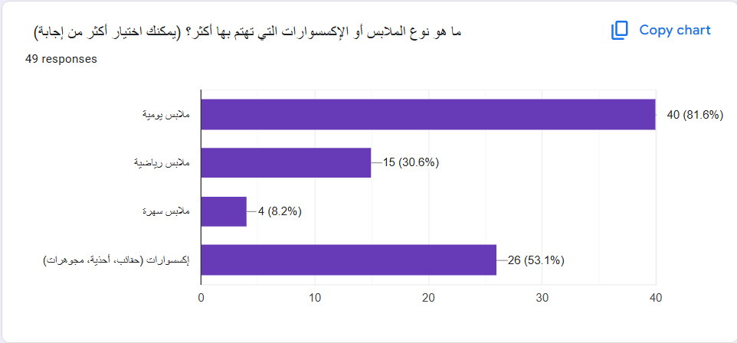
33

Slide 34
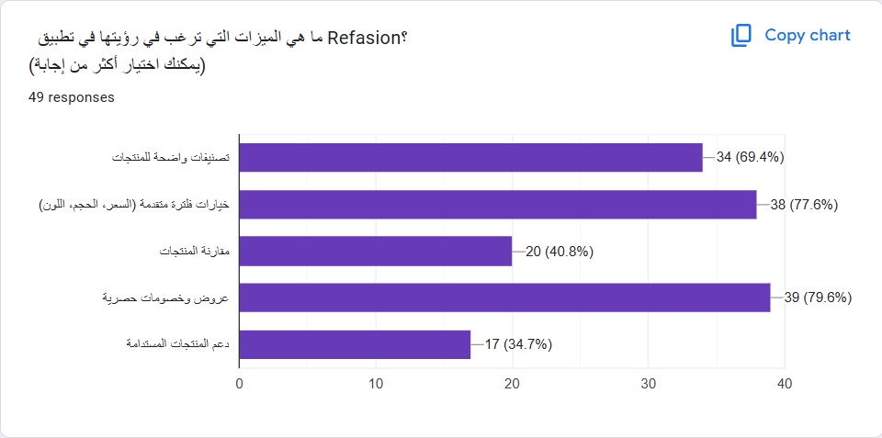
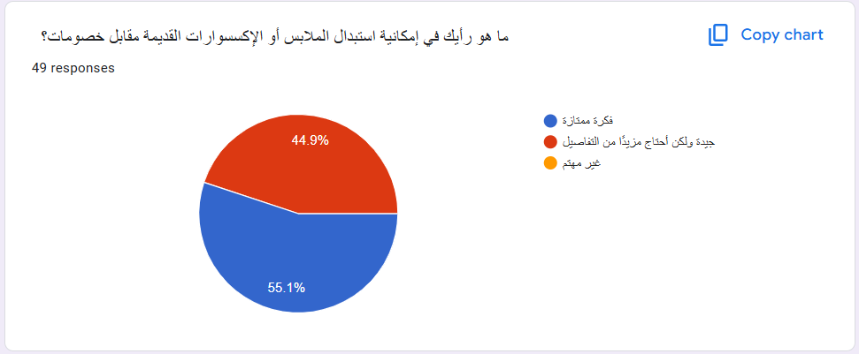
34

Slide 35
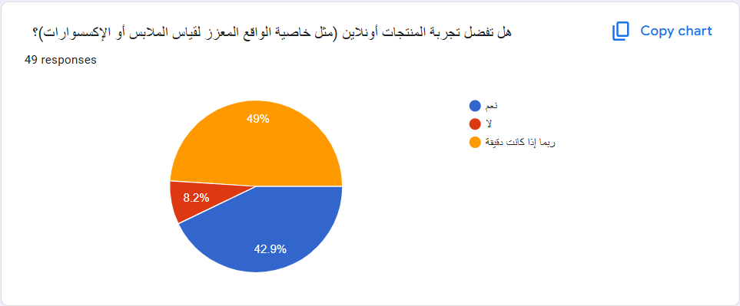
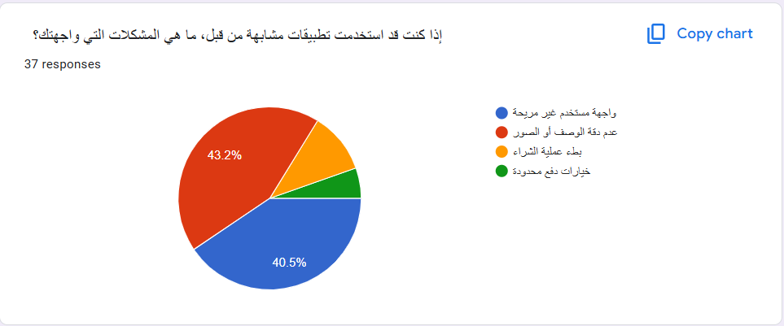
35

Slide 36
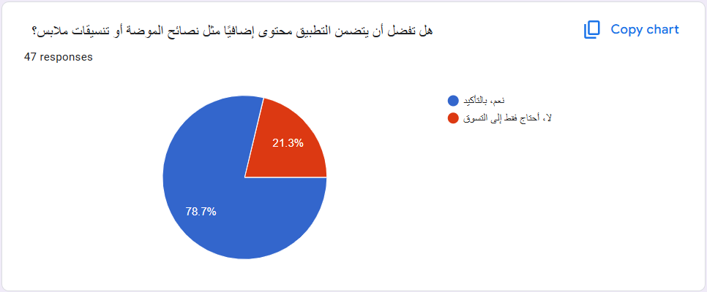
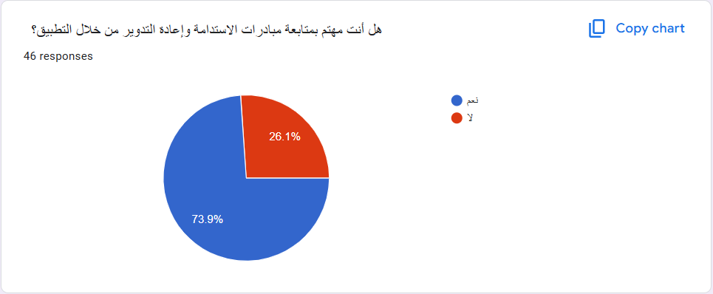
36

Slide 37
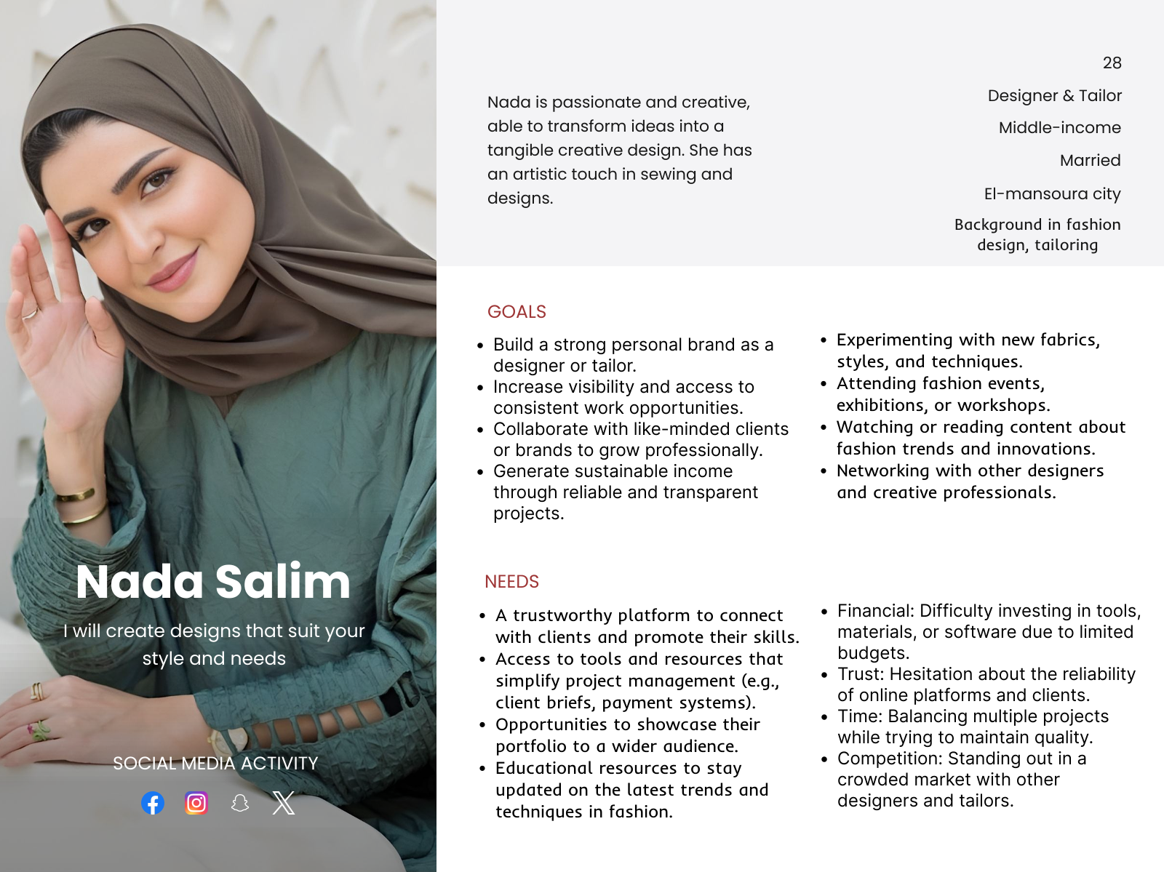
ABOUT
AGE OCCUPATION INCOME STATUS LOCATION Education
Buyer Persona 1
37

Slide 38
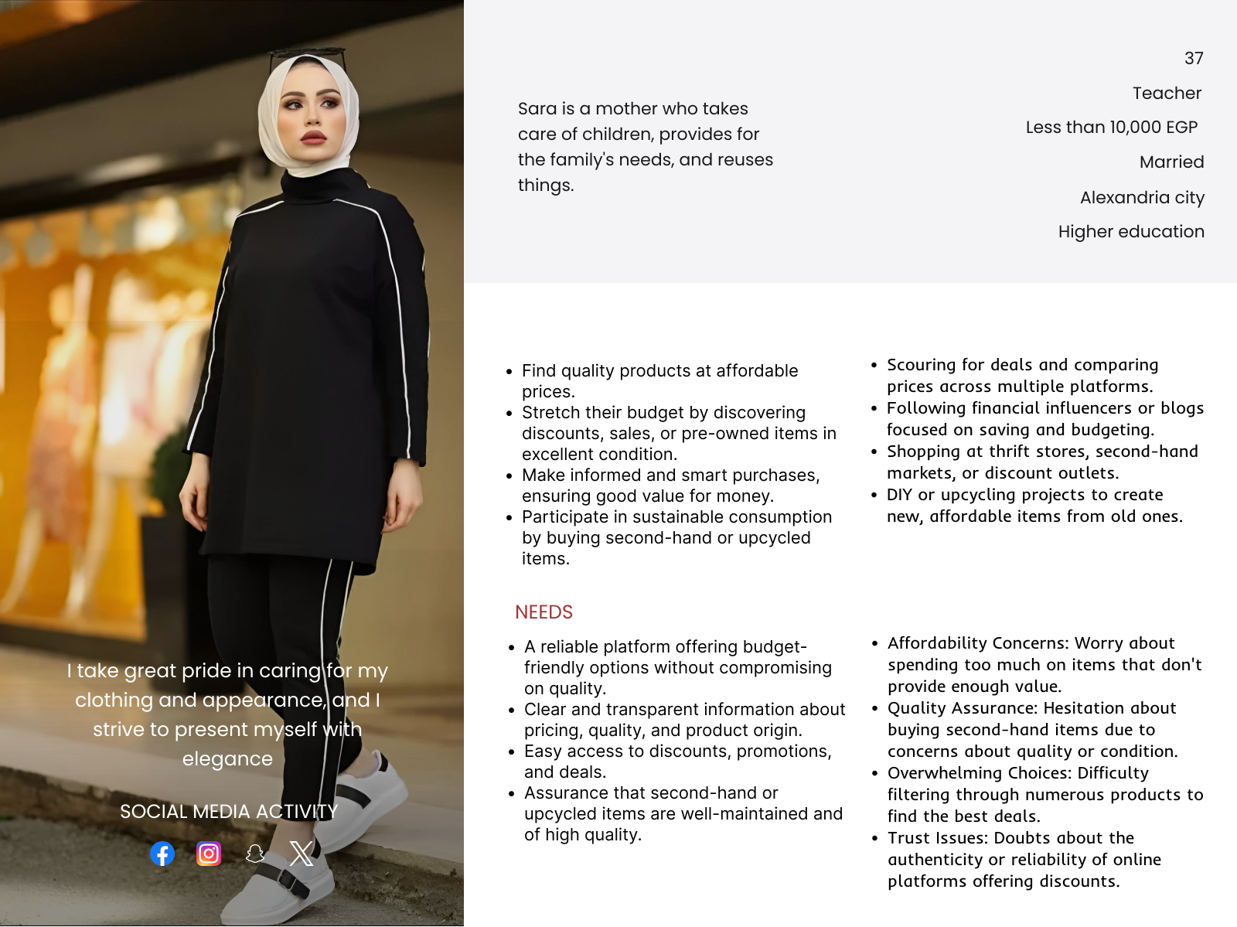
ABOUT
AGE OCCUPATION INCOME STATUS LOCATION Education
Buyer Persona 2
38

Slide 39
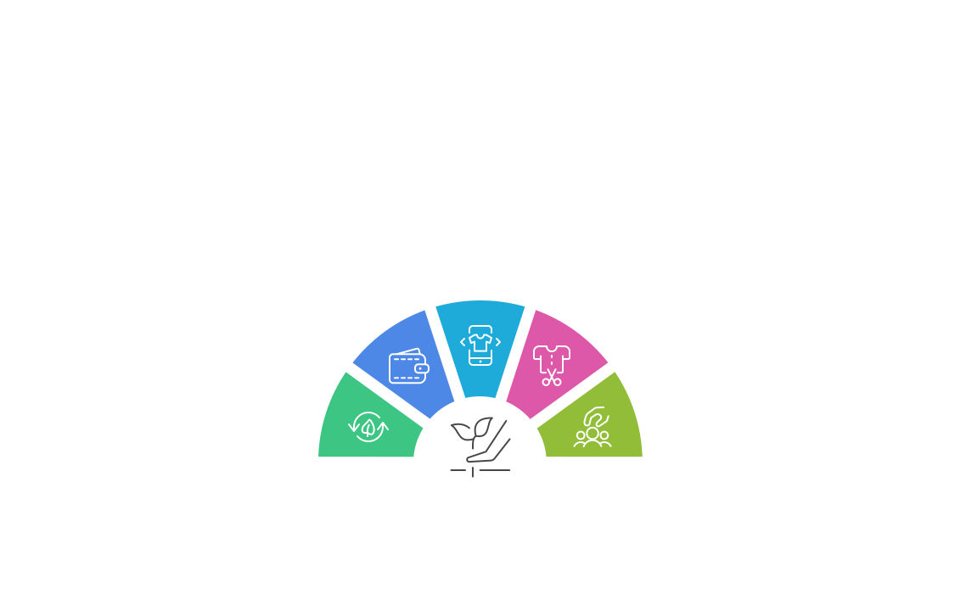
USP
Refashion bridges the gap between sustainability and style by providing a tech-driven upcycling and customization platform that allows users to transform old clothes into fashionable, unique pieces while reducing waste.
Key Differentiators:
Digital Experience
Local
Affordability
Provides AI-driven
Empowerment
recommendations via a
Offers budget-friendly
user-friendly app.
Supports independent
fashion redesigns
designers by connecting
tailored to individual
them with customers.
styles.
Community
Sustainability
Engagement
Focuses on reducing
Encourages users to
textile waste through
share their fashion
upcycling initiatives.
transformation stories.
39

Slide 40
TACTICS
40

Slide 41


Marketing Mix
Product
Price
Place
Promotion
Core Offering: Sustainable fashion marketplace + Clothing repair services.
- Features:
- AI-powered size recommendations.
- Eco-friendly packaging & repair kits.
- Subscription plans for regular clothing repairs.
- Before-and-after repair transformations to encourage sustainability.
Pricing Strategies:
- Dynamic pricing based on demand and product category.
- Competitive pricing for thrifted and repaired items.
- Tiered pricing for repair services (Basic, Premium, Custom).
- Subscription plans for premium users (discounts, faster repairs).
- First-time user discounts and referral rewards.
Sales & Distribution Channels:
- Primary: Mobile app (iOS & Android).
- Website: To expand reach and SEO benefits.
- Social Commerce: Instagram Shop, TikTok Shop, and Pinterest.
- Offline Presence: Pop-up shops and sustainable fashion events.
- Digital Marketing Strategies:
- SEO & Content Marketing: Blog articles on sustainable fashion.
- Social Media Ads: Targeted campaigns on TikTok & Instagram.
- Influencer Collaborations: Eco-conscious fashion influencers.
- UGC (User-Generated Content): Before-and-after repair stories.
- Email & Push Notifications: Personalized discounts and reminders.
41

Slide 42


Marketing Mix
People
process
Physical evidence
- Internal Team:
- Customer support trained in sustainability and fashion.
- Skilled tailors and fashion experts for repair services.
- Tech & AI specialists for app optimization.
- Customers:
- Targeting fashion-conscious & eco-friendly shoppers.
- Community building through forums & styling advice.
- Rewarding users for sustainability efforts (e.g., loyalty points).
- Seamless App Experience:
- Easy browsing, purchasing, and booking repair services.
- AI-driven personalization for clothing & repair suggestions.
- Instant support via in-app chat.
- Repair Service Process:
- Easy scheduling for clothing repairs.
- Clear updates on repair progress.
- Option to donate or recycle unsalvageable clothes.
- Online Presence:
- Aesthetic and user-friendly website & app.
- Strong social media branding (eco-conscious themes).
- Offline Assurance:
- Sustainable packaging with branding.
- High-quality repair work with before-and-after comparisons.
- Customer reviews and testimonials for credibility.
42

Slide 43
Channels
Channel | Purpose & Strategy
Instagram 📸 | Primary platform for visual storytelling, reels, and influencer collaborations.
TikTok 🎥 | Viral challenges, DIY upcycling videos, behind-the-scenes content.
Pinterest 📌 | Style inspirations, sustainable fashion ideas, mood boards.
Facebook 💬 | Community engagement, testimonials, sustainability articles.
LinkedIn 👔 | Thought leadership on sustainable fashion and business insights.
YouTube 🎞 | Tutorials, fashion transformation stories, long-form storytelling.
Website/Blog 📝 | SEO-driven content about sustainable fashion & Refashion services.
Email Marketing 📩 | Personalized fashion tips, exclusive offers, and community newsletters.
43

Slide 44
Posting Frequency and Timing
Platform | Posting Frequency
Instagram | Daily (Posts, Reels, Stories)
TikTok | 3-5 times per week
Pinterest | 3-4 times per week
Facebook | 3-4 times per week
LinkedIn | 2 times per week
YouTube | 1-2 times per month
Email Marketing | Bi-weekly newsletters
Platform | Best Posting Time
Instagram & TikTok | 6-9 PM (peak engagement) & 12-2 PM (midday browsing)
Facebook | 7-10 PM (after work/school hours)
Pinterest | 8-11 PM (evening inspiration browsing)
LinkedIn | 8-10 AM & 5-7 PM (business hours)
YouTube | Saturdays & Sundays at 12 PM (weekend viewers)
Email Marketing | Tuesdays & Thursdays at 9 AM (high open rates)
44

Slide 45
Tone of voice
Tone Attribute | How It Reflects in Content
Conversational & Relatable | Speaks directly to the audience as a fashion friend.
Educational & Inspiring | Shares DIY tips, sustainability facts, and success stories.
Empowering & Inclusive | Encourages community participation & eco-conscious actions.
Trendy & Fun | Uses popular challenges, viral sounds, and aesthetic visuals.
Call-to-Action Oriented | Every post has a clear CTA (e.g., “Try this look!,” “Tag us in your upcycled outfits!”).
45

Slide 46
Content Ideas
Content Type | Purpose | Best Platform
Before & After Transformations | Showcases the power of upcycling. | Instagram, TikTok, YouTube
DIY Upcycling Tutorials | Educates users on how to repurpose their clothes. | TikTok, YouTube, Blog
Sustainability Facts & Tips | Raises awareness about fashion waste. | Instagram, Facebook, LinkedIn
User-Generated Content (UGC) | Encourages customers to share their fashion transformations. | Instagram, Pinterest
Influencer & Designer Features | Highlights collaborations with fashion creators. | Instagram, YouTube
Polls & Quizzes | Interactive content to engage audiences. | Instagram Stories, Facebook
Giveaways & Contests | Boosts engagement and community participation. | Instagram, TikTok
Behind-the-Scenes (BTS) | Showcases the brand’s process and values. | TikTok, YouTube Shorts
Customer Testimonials | Builds credibility and trust. | Instagram, Facebook, Website
Live Q&A & Styling Sessions | Engages users directly with experts. | Instagram Live, TikTok Live
46

Slide 47
Step | Action
1. Content Creation 🎨 | Design visuals, film videos, and create engaging captions.
2. Scheduling & Posting 📅 | Use tools like Meta Business Suite, Buffer, or Later to schedule posts in advance.
3. Engagement & Community Management 💬 | Respond to comments, DMs, and interact with followers daily.
4. Influencer & Partner Collaborations 🤝 | Work with eco-conscious fashion influencers to amplify reach.
5. Data Tracking & Optimization 📊 | Analyze performance metrics & adjust strategy based on engagement.
6. Paid Ads & Promotions 💰 | Invest in targeted social media ads for better reach.
7. Growth Experiments & Trends 🔥 | Test new formats, viral trends, and emerging content styles.
Action Plan
47

Slide 48
Day | Platform | Content Type | Example Post
Monday | Instagram Reels | Before & After Transformation | “Turn old jeans into a trendy jacket! 🔥♻”
Tuesday | TikTok | DIY Upcycling Tutorial | “How to turn an oversized tee into a crop top! ✂”
Wednesday | Instagram Stories | Polls & Engagement | “Which outfit do you prefer? Vote now! 👗”
Thursday | YouTube | Long-form Sustainability Guide | “5 ways to make your wardrobe more sustainable! 🌍”
Friday | Pinterest & Facebook | User-Generated Content | “Check out @user’s amazing Refashioned outfit! 😍”
Saturday | Instagram & TikTok | Giveaways & Contests | “Win a free upcycled outfit! Enter now! 🎁”
Sunday | LinkedIn & Blog | Educational Post | “The impact of fast fashion on our planet – and how to fix it.”
Sample Content Calendar
48

Slide 49
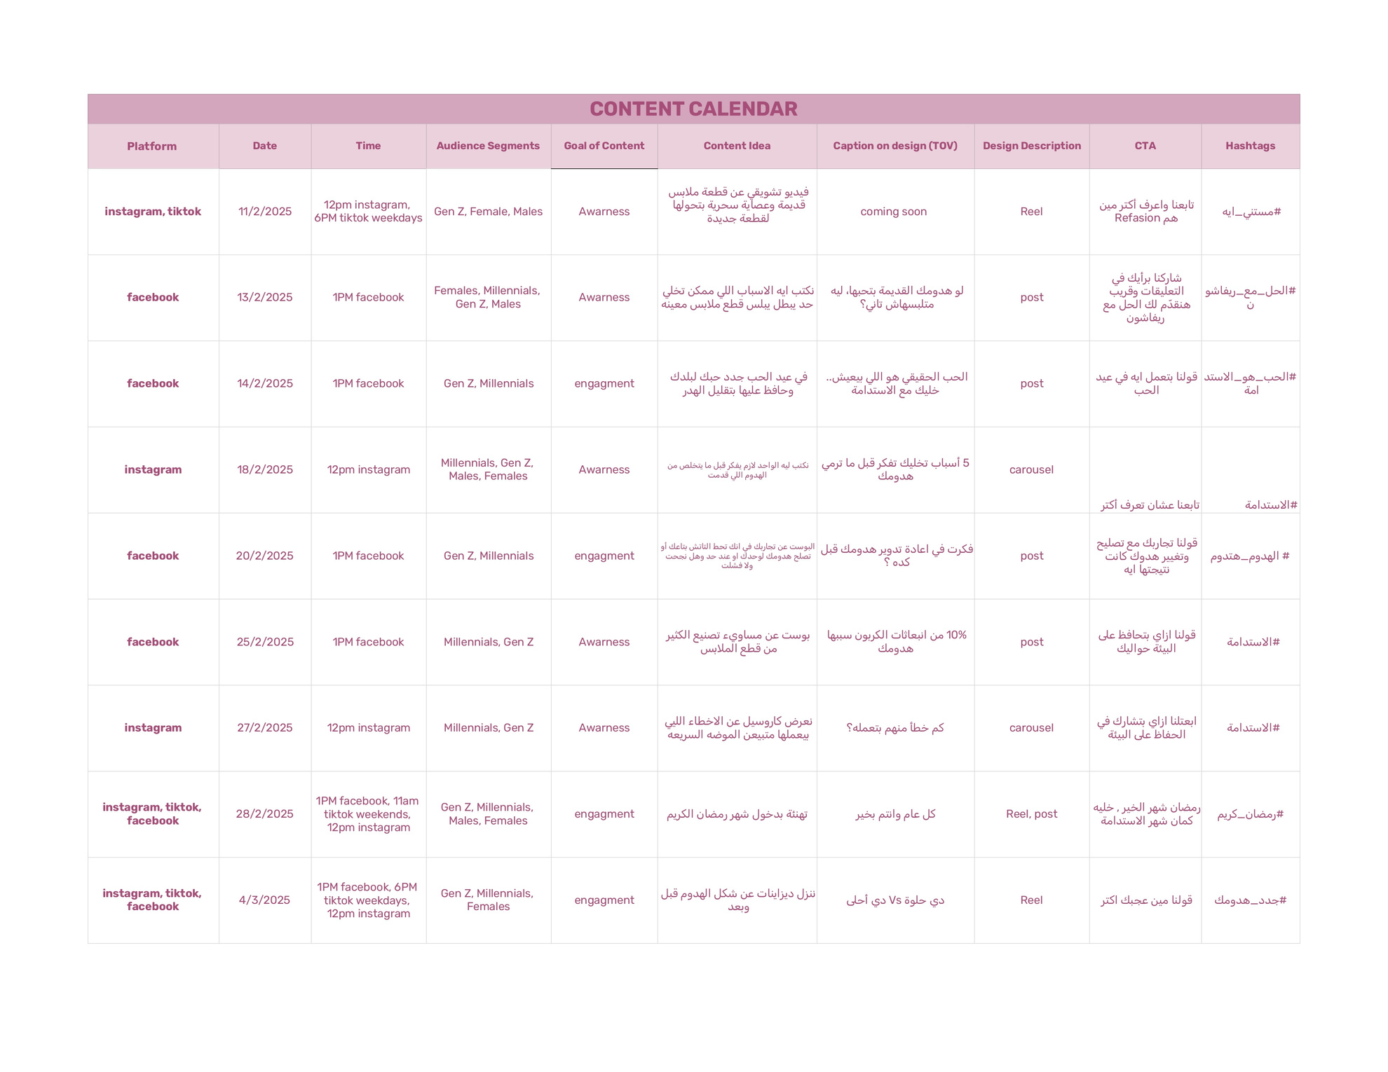

For
Full
Calendar
49

Slide 50
Marketing channels & KPIs
Marketing channels:
Ads Manager for Facebook & Instagram
KPIs :
Number of followers, shares, and reach
Provide the correct formulas for the following KPIs:
CPM (Cost per 1,000 Impressions)
= amount spend / (num of impression)× 1000
Link Click-Through Rate
= Link Clicks / Impressions × 100
CPLC (cost per link click)
= Amount Spent(USD) / Link Clicks
Click To Lead Rate
= Results(Leads) / Link Clicks × 100
Cost per Results
= Amount Spent(USD) / Results(Leads)
50

Slide 51

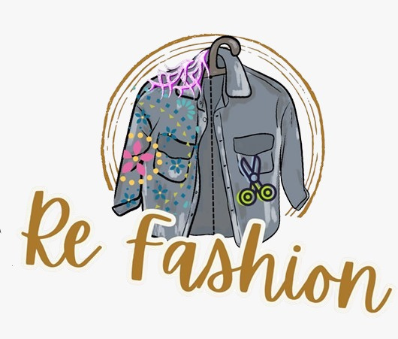

ready to launch ?
FOLLOW
51

Slide 52
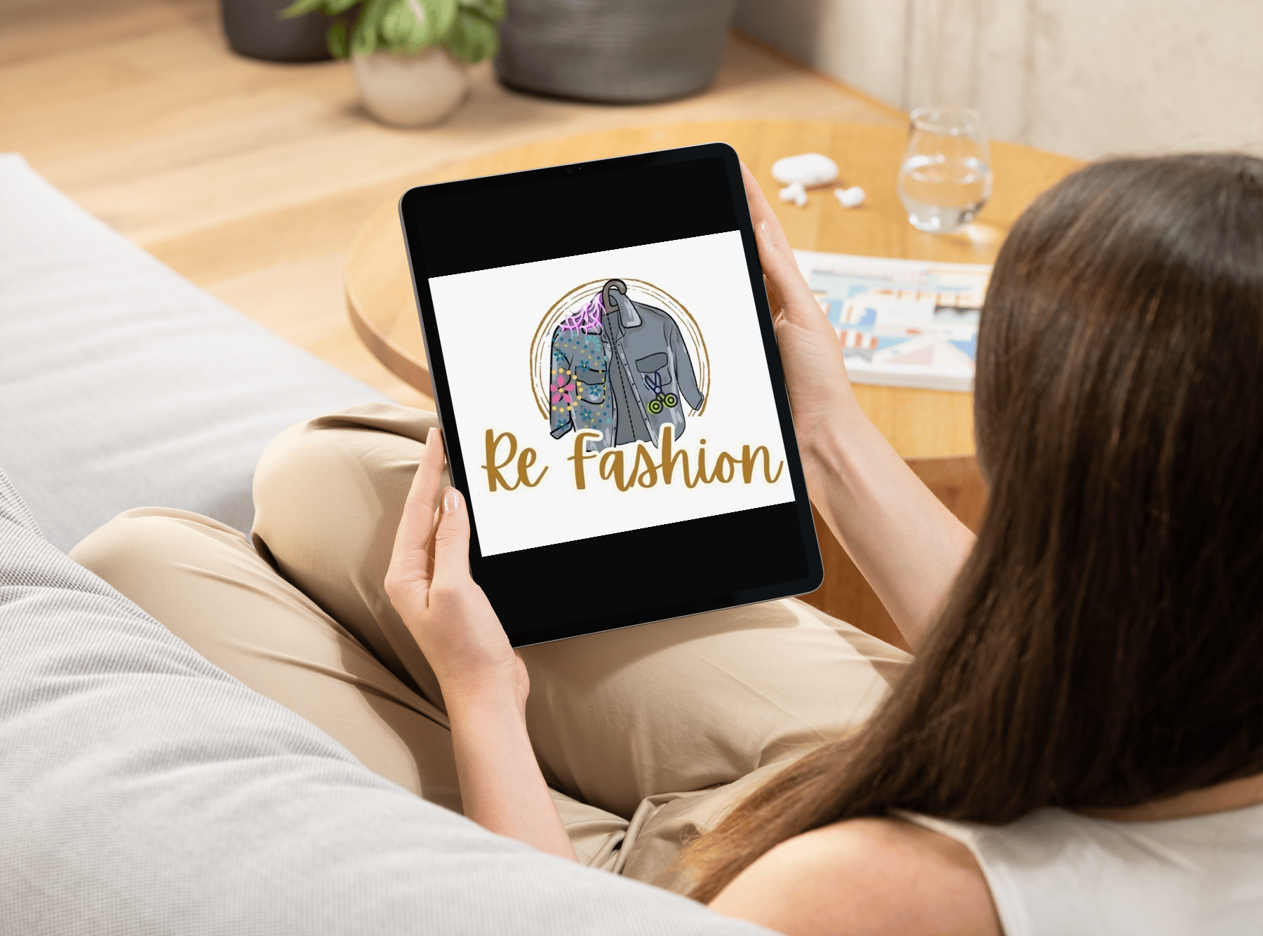
52

Slide 53
We have completed all the necessary steps for the project, including:
Market Research & Planning – Conducted thorough research to understand the target audience and competitors.
Brand Strategy Development – Defined the brand identity, messaging, and positioning.
Platform Selection – Identified and set up the project's most suitable social media platforms.
Content Strategy Creation – Developed a comprehensive content plan, including themes, formats, and posting schedules.
Visual & Media Production – Designed graphics, videos, and other media assets tailored to the brand.
Now, the remaining tasks are:
Finalizing content writing to ensure consistency and quality.
Initial account setup & optimization to ensure all social media profiles are fully optimized.
Publishing on the selected social media pages according to the content calendar.
Running advertising campaigns to maximize reach and engagement.
Preliminary engagement & community building to start interacting with the audience and generating interest.
Collaboration & influencer outreach (if applicable) to establish partnerships with relevant influencers or industry figures.
53

Slide 54
Thanks
54

